Slide 1
DIGITAL ASSEMBLY FINAL

Slide 2
PLEASE WELCOME…
Add teacher’s name
Add teacher’s title

Slide 3
1,000
Year 10 students will take on the challenge
in the West Midlands 2019-2020

Slide 4
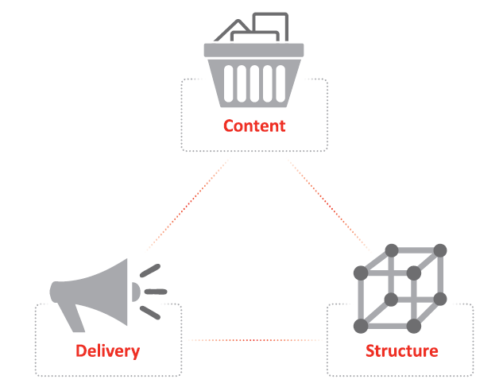

Slide 5
SPEAKING AT TODAY’S SPEAK OFF
Add student’s name
Add student’s name
Add student’s name
Add student’s name
Add student’s name

Slide 6
THANK YOU for your support
Our winner will go on to speak alongside finalists from all over the West Midlands at a Digital Final hosted on Zoom.
We will share the date of the Digital Final soon – everyone is welcome to attend!

